Slide 1
UTILIZING PLAY THERAPY AND EXPRESSIVE ART INTERVENTIONS WITH FIRST RESPONDERS
Laura Fazio-Griffith, Ph.D., LPC-S, LMFT, Registered Play Therapist-S
Reshelle Marino, Ph.D., LPC-S
Dalina Dahlmans, Graduate Student
Bailey Zachary, Graduate Student
Southeastern Louisiana University

Slide 2
FIRST RESPONDERS
EMTs, firefighters, and police officers
Designated and trained to immediately respond to a scene of an accident or emergency to provide assistance
Essential to the community but over time increases the risk of trauma

Slide 3
Understanding the experience: Critical Incidents
MIstakes that injures/kills colleague | Mistake that injures/kills bystander | Colleague killed intentionally
Colleague killed accidentally | Being taken hostage | Being seriously beaten
Being shot at | Colleague injured intentionally | Killed or injured in line of duty
Badly beaten child | Sexually assaulted child | Threatened with a gun
Your loved ones threatened | Seriously injured intentionally | Badly beaten adult
LIfe threatening man-made disaster | Exposed to disease | Colleague injured accidentally
Shoot as suspect without injury | Threatened with weapon | Mutilated body or human remains
Life threatening natural disaster | Life threatened by toxic substance | See someone dying
Make a death notification | Being seriously injured accidentally | LIfe threatening high speed chase
Sexually assaulted adult | Animal neglected, tortured, killed | Decaying corpse
Life threatened by dangerous animal | Body of someone recently deceased/killed
Chopko et al., 2015

Slide 4
Understanding the Experience
Frequent exposure to “death, injury, pain, or loss as well as direct exposure to personal safety, long hours of work, frequent shifts and longer shift hours, poor sleep, physical hardships, and other negative experiences,” with little to no break between events (Substance, 2018, p.4).
Average number of critical incidents witnessed over a career was 188. ( Chopko, Palmieri, and Adams, 2015)
Job first state of mind: detachment, quick assessment, and self-directed immediate response that is difficult to turn off. (Flannery, R. 2015)
Mindset of vigilance
Results in elevated rates of depression, substance abuse, PTSD/stress, and suicide/suicide ideation that are more than the general population

Slide 5
REASONS FOR EXPRESSIVE ARTS
Trauma, loss, lack of sleep, depression, PTSD, burnout, substance use, suicidal ideation
Promote self-confidence, and sharing their experiences and reactions strengthens their sense of identity and worth
Require individualized, patient-centered, holistic, and trauma-informed care that can be facilitated through art therapy
Lead to establishing connection to others, reconnection with the self, and, most importantly, empowerment

Slide 6
REASONS FOR EXPRESSIVE ARTS
Promotes a therapeutic relationship and helps guide the process of recovery in First Responders
It can foster connections, relationship, instilling hope, promoting identity and build strength
Expressive arts are powerful because they offer clients to make choices as well as give clients a sense of control.
Crucial to incorporate creativity and flexibility in interventions to improve self-esteem, hope, and prosocial behavior

Slide 7
EXPRESSIVE ART TECHNIQUES WITH FIRST RESPONDERS
Allows self-regulation skills as they process and re-examine the trauma
Process the trauma since it allows non-verbal processing of the trauma in a safe environment and regain control, feel empowered, and gives first responders freedom of emotional expression
It can help raise bodily awareness and advocacy in clients who struggle with verbally expressing their traumatic memories

Slide 8
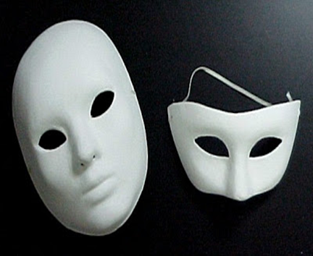
EXPRESSIVE ART TECHNIQUES AND PLAY THERAPY INTERVENTIONS WITH FIRST RESPONDERS:
Masking/Sculpting
Allows client to look at the “mask” he or she wears.
Creates opportunity to discuss real emotions and when it is appropriate to remove “the mask”

Slide 9
EXPRESSIVE ART TECHNIQUES AND PLAY THERAPY INTERVENTIONS WITH FIRST RESPONDERS: Eco-Mapping
Allows the client to see connections with others to improve self- worth and self-concept
Allows the counselor to track changes in support network over time
http://www.dhs.state.mn.us/main/groups/children/documents/pub/dhs16_178770.pdf

Slide 10
EXPRESSIVE ART TECHNIQUES AND PLAY THERAPY INTERVENTIONS WITH FIRST RESPONDERS: Eco-Mapping

Slide 11
ALASEXPRESSIVE ART TECHNIQUES AND PLAY THERAPY INTERVENTIONS WITH FIRST RESPONDERS: MAND
Mandala (Sanskrit: मण्डल, lit, circle) is a spiritual and ritual symbol in Indian religions, representing the universe. In common use, "mandala" has become a generic term for any diagram, chart or geometric pattern that represents the cosmos metaphysically or symbolically; a microcosm of the universe.

Slide 12
EXPRESSIVE ART TECHNIQUES AND PLAY THERAPY INTERVENTIONS WITH FIRST RESPONDERS: MANDALAS

Slide 13
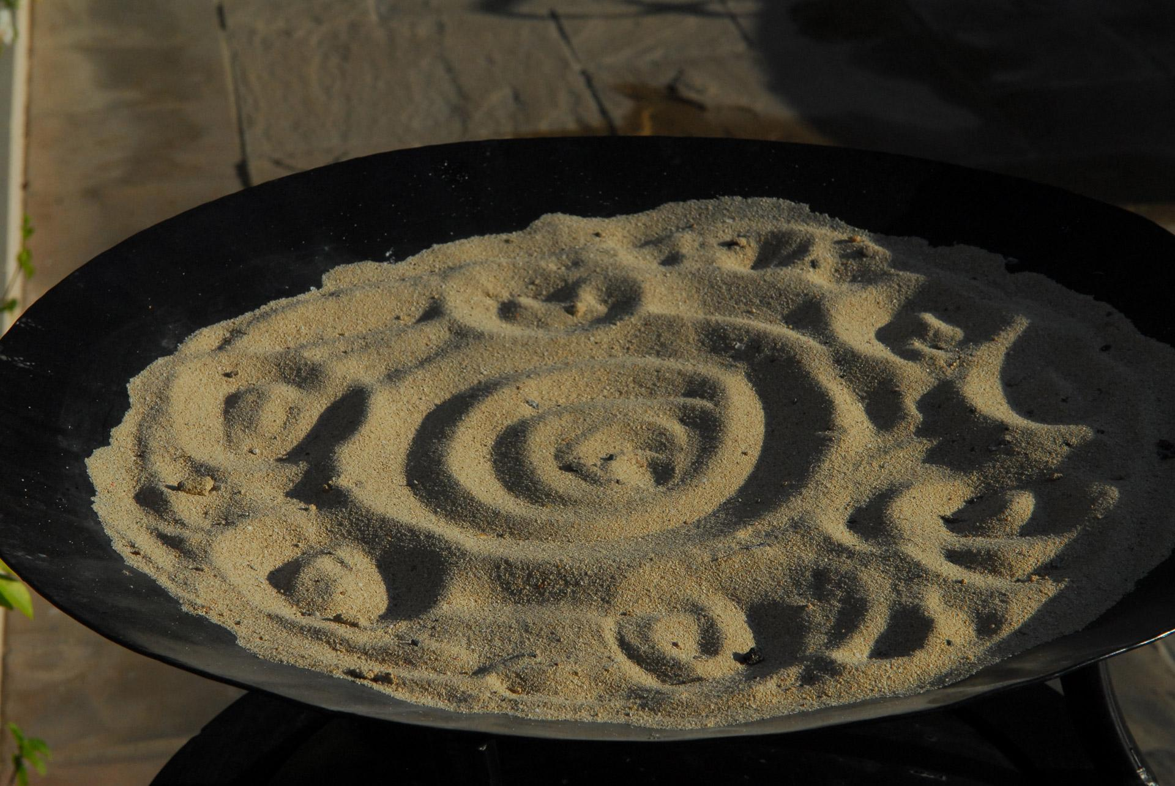
EXPRESSIVE ART TECHNIQUES AND PLAY THERAPY INTERVENTIONS WITH FIRST RESPONDERS: SAND TRAY
Gives expression to nonverbalized emotional issues
Has kinesthetic quality- sensory experience
Allows therapeutic distance
Safe place for abreaction
Effective for traumatized clients
Allows families to communicate nonverbally
Provides boundaries and limits
Allows therapeutic metaphors to emerge

Slide 14
EXPRESSIVE ART TECHNIQUES AND PLAY THERAPY INTERVENTIONS WITH FIRST RESPONDERS: SUPERVISION AND EXPRESSIVE ARTS
Supervisee is having difficulty conceptualizing.
Supervisee is having some counter transference.
Difficulty with the supervisee/ supervisor relationship.
Resistance to the supervision process.
Supervisees developmental level is not congruent with skill level.
Supervisee has difficulty receiving feedback.
Supervisee has difficulty collaborating with other clinicians and supervisor.

Slide 15
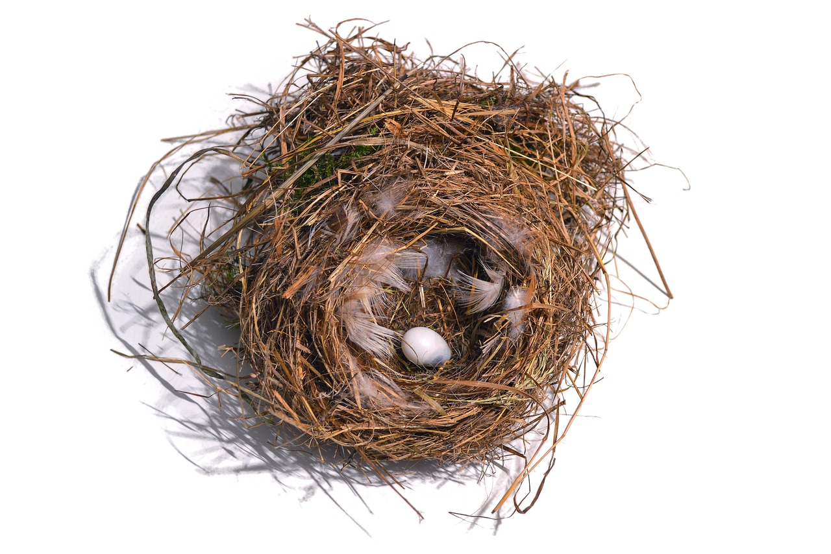
EXPRESSIVE ART TECHNIQUES AND PLAY THERAPY INTERVENTIONS WITH FIRST RESPONDERS: SUPERVISION AND EXPRESSIVE ARTS: ACTIVITY
Build a Nest
Purpose: The supervisor may conduct this activity early in the supervisory relationship to help identify the supervisee’s safety needs, however it can be beneficial to use at any time in the supervisory relationship, specifically helpful for supervisees working with trauma and first responders.
Materials: Items that the supervisee gathers to build a nest, using only materials that have fallen on the ground, and staying in safe, public areas.

Slide 16
EXPRESSIVE ART TECHNIQUES AND PLAY THERAPY INTERVENTIONS WITH FIRST RESPONDERS: SUPERVISION AND EXPRESSIVE ARTS: ACTIVITY
Procedure: In this activity, the supervisee is invited to build a nest. To begin, the supervisor suggests that the supervisees may take time to think about or even write down what goes in a bird’s nest. Instead, they may decide to go outside immediately to gather materials.
Be sure to allow sufficient time for supervisees to collect materials and to reconvene to build their nests. When the nests are completed, the supervisor and supervisees process the experience and share observations.

Slide 17
EXPRESSIVE ART TECHNIQUES AND PLAY THERAPY INTERVENTIONS WITH FIRST RESPONDERS: SUPERVISION AND EXPRESSIVE ARTS: ACTIVITY
Processing: A few sample prompts and questions are shown below:
“Tell us about the nest you created.” “What qualities did you decide to incorporate in your nest?” “Was it a challenge to determine what items to select and did you change your mind about what you wanted to build as you selected items?” “What pleases you about it?” “Is there some aspect you are not quite satisfied with?” “What else does your nest need?”

Slide 18
EXPRESSIVE ART TECHNIQUES AND PLAY THERAPY INTERVENTIONS WITH FIRST RESPONDERS: SUPERVISION AND EXPRESSIVE ARTS: ACTIVITY
A variation of this activity is to ask supervisees to write a story about the nest (with a beginning, middle and end) and then title it. If desired, the supervisor can also explore characteristics of the inhabitant of the nest with questions such as, “What kind of bird lives in your nest?” “Does it live alone or with others?” “What does it do well?” “What dangers does it face?” “How does it protect itself?” “Is your bird content with its nest?” “What else does your bird need to flourish?”
Reference: Anne L. Stewart
Lennis G. Echterling
Chapter 4: Attachment-Based Play Techniques for Enhancing Growth in Supervision In Techniques and Interventions for Play Therapy and Clinical Supervision, Fazio-Griffith, L., & Marino, R. (In Press, 2020) Eds.

Slide 19
EXPRESSIVE ART TECHNIQUES AND PLAY THERAPY INTERVENTIONS WITH FIRST RESPONDERS: SUPERVISION AND EXPRESSIVE ARTS: ACTIVITY
A Handful of Guidance
Purpose: Everyone needs a helping hand. A tension in therapy and supervisory relationships is the need to feel and appear competent, while also needing to ask for and receive assistance. This exercise helps identify these competing facets and can stimulate a conversation to explore and personalize the goals of supervision, along with clarifying how the supervisee may best receive support from the supervisor. This activity works well with supervisees who work with clients exposed to trauma and challenging clients.
Materials: Sheet of paper, colored pencils, pens, markers, or crayons.

Slide 20
EXPRESSIVE ART TECHNIQUES AND PLAY THERAPY INTERVENTIONS WITH FIRST RESPONDERS: SUPERVISION AND EXPRESSIVE ARTS: ACTIVITY
Procedure: Supervisees are invited to trace their hand on a sheet of paper and respond to the prompt for each finger with a word, phrase, or symbol:
Index (or pointer) finger—Share a direction you wish to travel or a goal you wish to strive for in supervision.
Middle finger—Identify a stressor or frustration you anticipate or experience in supervision.
Ring finger—Note how you might show your commitment to the process of supervision.
Pinky finger—State how you may present and/or hope to present yourself in supervision.

Slide 21
EXPRESSIVE ART TECHNIQUES AND PLAY THERAPY INTERVENTIONS WITH FIRST RESPONDERS: SUPERVISION AND EXPRESSIVE ARTS: ACTIVITY
Thumb—Share what and who helps you hold it together when you are experiencing troubling times.
Processing: The supervisor can process this experience by asking, for example, “What discoveries did you make about yourself in this activity?” or “What are the common themes that emerge among your fingers?” or “How can supervision help you to hold it together during the challenges you will face?”
Reference: Anne L. Stewart
Lennis G. Echterling
Chapter 4: Attachment-Based Play Techniques for Enhancing Growth in Supervision In Techniques and Interventions for Play Therapy and Clinical Supervision, Fazio-Griffith, L., & Marino, R. (In Press, 2020) Eds.

Slide 22
References
Chopko BA, Palmieri PA, Adams RE. Critical incident history questionnaire replication: frequency and severity of trauma exposure among officers from small and midsize police agencies. J Trauma Stress. 2015
Flannery, R. (2015). Treating Psychological Trauma in First Responders: A Multi-Modal Paradigm. Psychiatric Quarterly, 86(2), 261–267.
Kottman, T. (2011). Play therapy basics and beyond (2nd ed.). Alexandria, VA: American Counseling Association
Lee, R. K. (2019). Expressive arts as a treatment for survivors of sexual trauma: Studying the phenomenon and efficacy of expressive arts use with adult survivors of commercial sexual exploitation. A clinical dissertation for the degree of Doctor of Psychology Pepperdine University. Retrieved from: https://media.proquest.com/media/pq/classic/doc/4327460469/fmt/ai/rep/NPDF?_s=GMnd8rJsMUCnIqXYeQ4bWkWAIqo%3D
Litam, S. D. A. (2017). Human Sex Trafficking in America: What Counselors Need to Know. The Professional Counselor, 7(1), 45–61. doi: 10.15241/sdal.7.1.45
Lowenstein, L. (2011). Favorite therapeutic activities for children, adolescents, and families. Champion Press: http://www.lianalowenstein.com/e-booklet.pdf
Landreth, G. (2012). Play therapy: The art of the relationship (3rd ed.). London, England: Routledge.
Stewart. A.L., & Echterling, L. G. Attachment-based play techniques for enhancing growth in supervision In Techniques and Interventions for Play Therapy and Clinical Supervision, Fazio-Griffith, L., & Marino, R. (In Press, 2020) Eds.
Substance Abuse and Mental Health Services Administration. (May 2018). First Responders: Behavioral Health Concerns, Emergency Response, and Trauma. Disaster Technical Assistance Center Supplemental Research Bulletin. (pp. 1–15)

